Slide 1
PRODUCTIVITY SOUTH AFRICA ENTERPRISE SUPPORT PROGRAMME

Slide 2
CONTENTS
Productivity South Africa
Regional Footprint
Functions Of Productivity South Africa
Productivity SA Enterprise Support Programmes

Slide 3
PRODUCTIVITY SA MANDATE
Productivity SA is a Schedule 3A Public Entity of the Department of Employment and Labour with the mandate to promote employment growth and productivity thereby contributing to South Africa’s socio-economic development and competitiveness as per Employment Services Act 4 of 20014, Chapter 5.
VISION
To lead and inspire a productive and competitive South Africa
MISSION
To improve productivity by diagnosing, advising, implementing, monitoring and evaluating solutions aimed at improving South Africa’s sustainable growth, development and employment through increase competitiveness
VALUE PROPOSITION
Provide Productivity and Competitiveness Improvement Solutions to enhance the productivity and operational efficiency of enterprises throughout the business lifecycle to accelerate the creation of wealth and decent work.
COUNTRY
Constitution, NDP, MTSF, Competitiveness Indices (eg IMD and WEF)
INDUSTRY
Sector Master Plans, Productivity Statistics, Sector Studies
ENTERPRISE LEVEL
Competitiveness Improvement Solutions (CIS) and Business Turnaround and Recovery (BT &R)

Slide 4
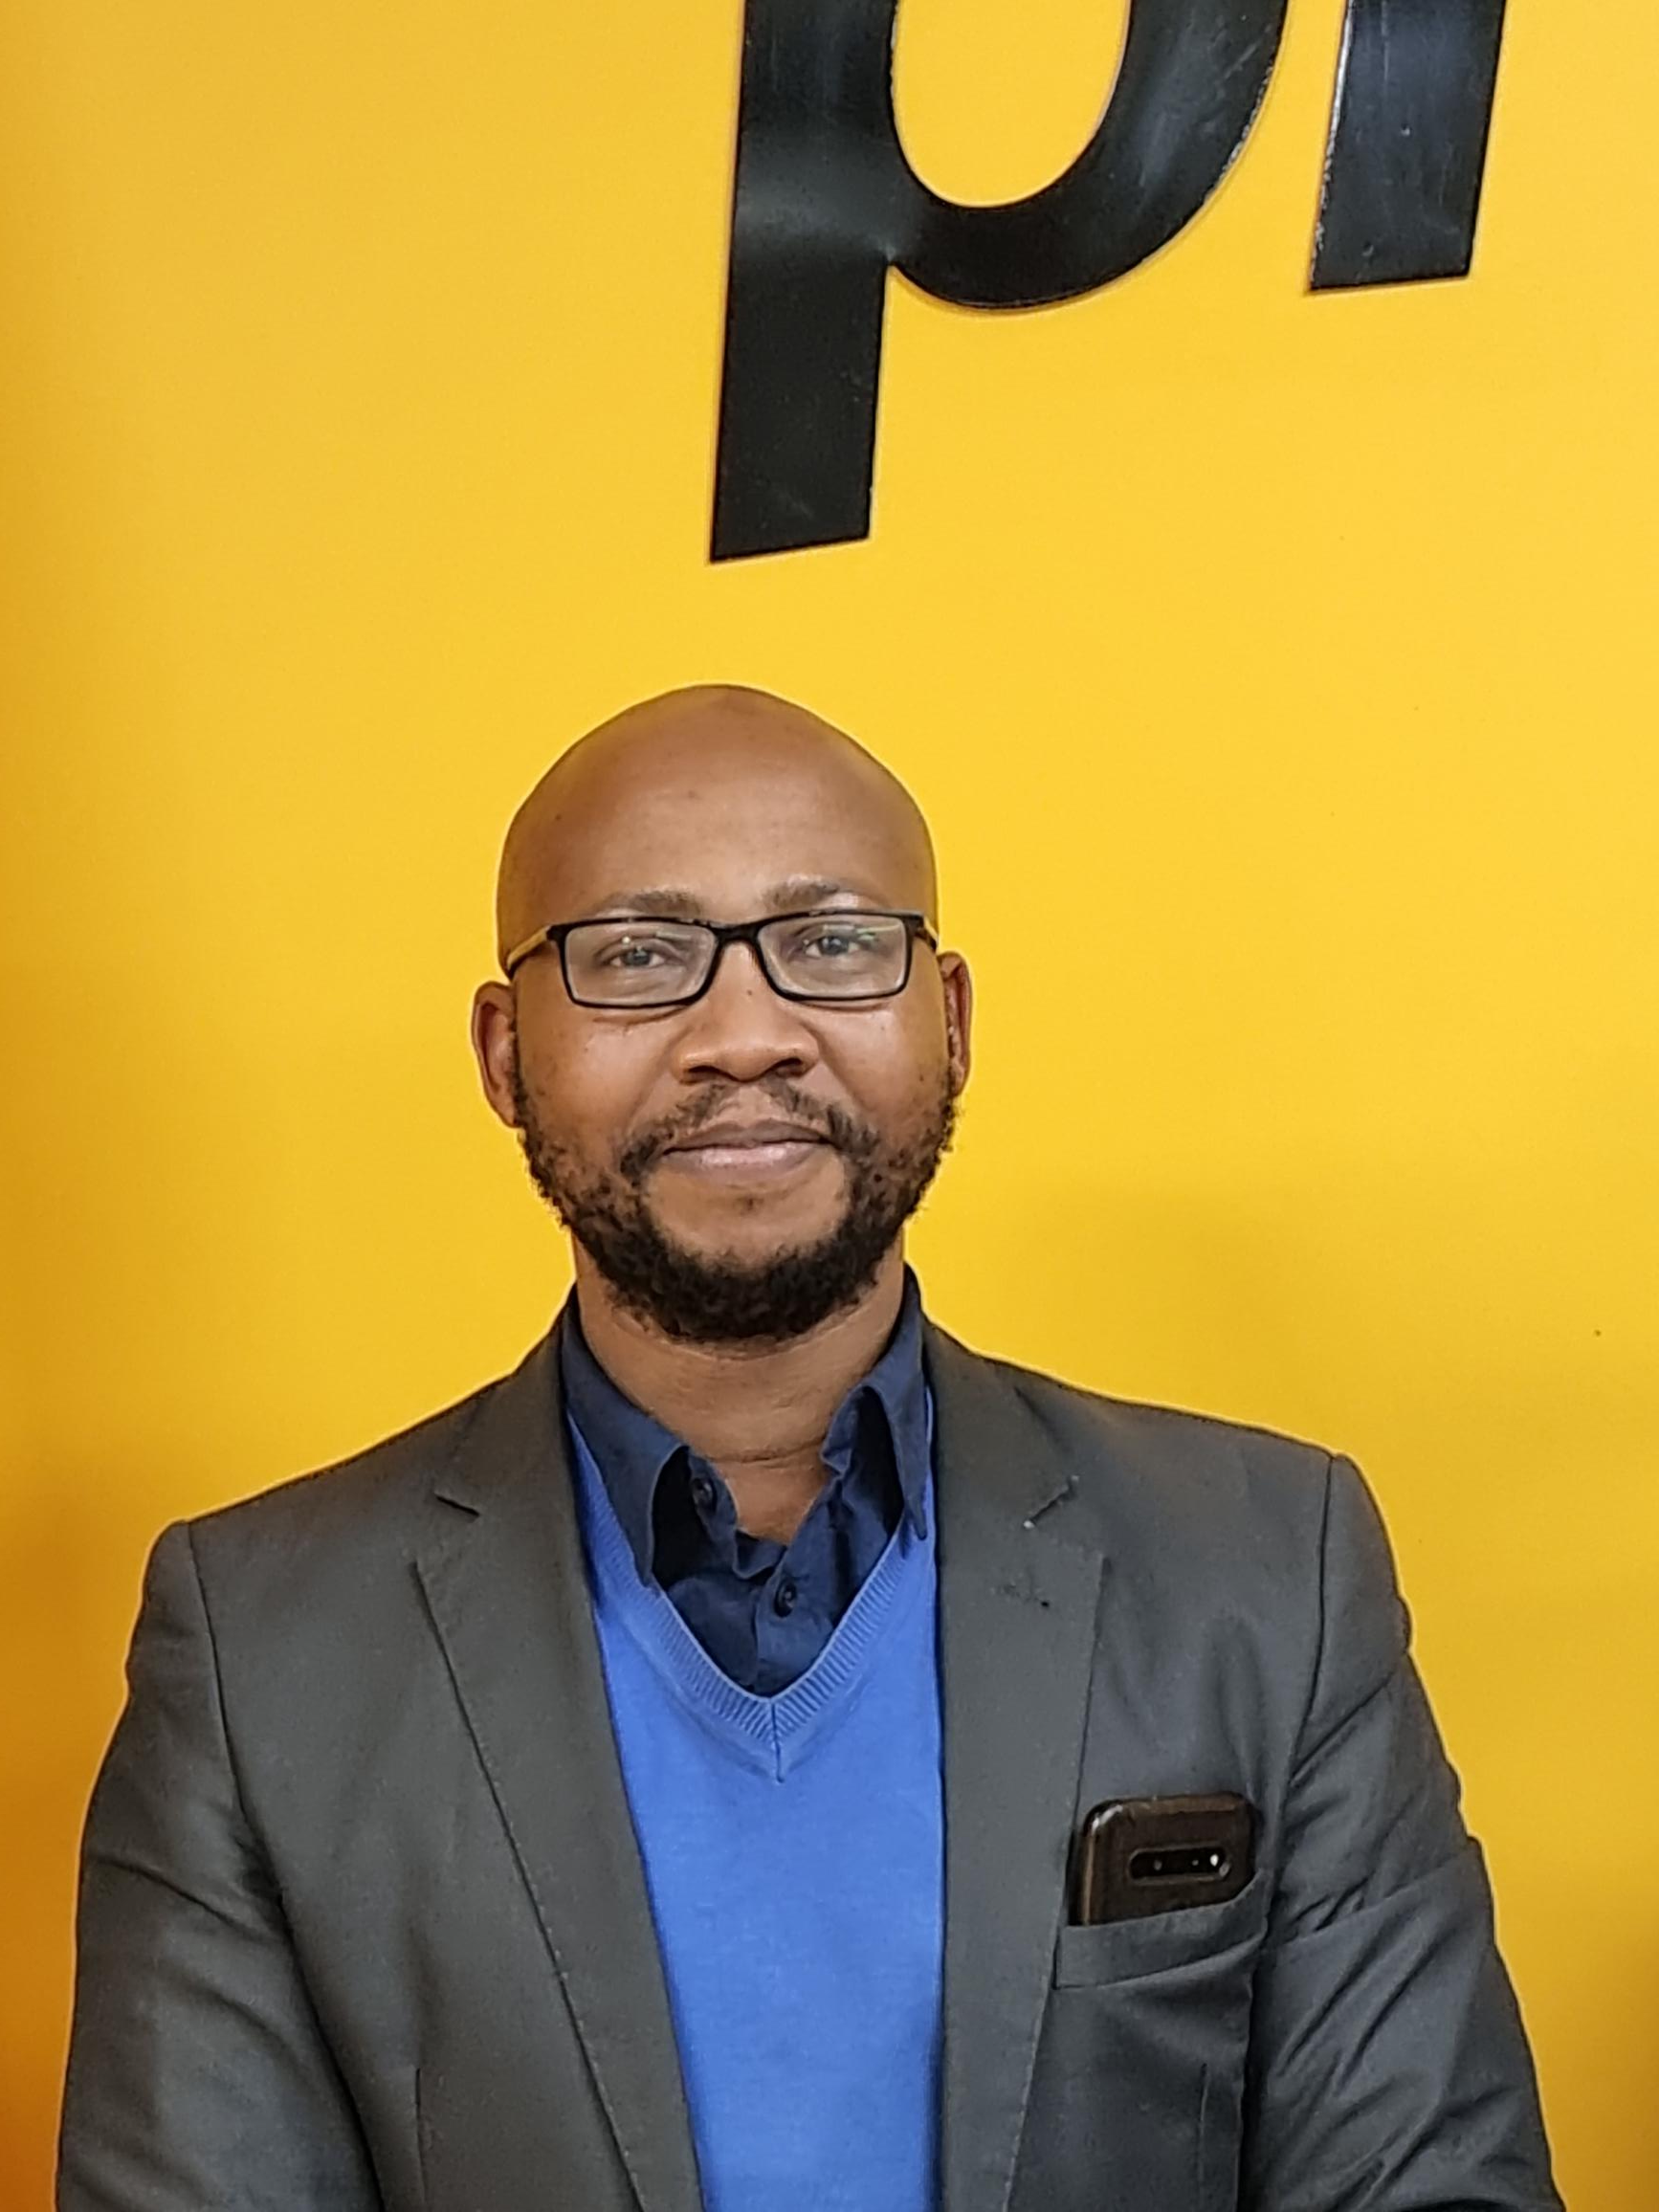
REGIONAL FOOTPRINT
Tel: 031 268 9770
Region 1
Acting Executive Manager
Ms Fulufhelo Madzhie
Office: Midrand
International Business Gateway
Cnr. New Road and Sixth Roads, Midrand,
Tel: 011 848 5300
Region 2
Executive Manager: Mr Philiswa Mnguni
Office: Cape Town
Suite 202, 2nd Floor
Edward III Building, 70 Edward Street
Bellville
Tel: 021 910 1591
Region 3
Acting Executive Manager:
Ms Amelia Naidoo
Office: eThekwini/Durban
Suite 201, Cowey Park
91-123 Cowey Road
Essenwood
REGION 1
Gauteng, North West, Limpopo
REGION 2
Western Cape, Free State, Northern Cape
REGION 3
KwaZulu Natal, Eastern Cape, Mpumalanga

Slide 5
Functions of Productivity South Africa
Section 31 (1) of the Employment Services Act No. 4 of 2014 established Productivity South Africa as a juristic person to promote employment growth and productivity.
Section 32 of the Employment Services Act No. 4 of 2014 provides for the functions of Productivity South Africa as follows:
(a) to promote a culture of productivity in the workplace;
(b) to develop relevant productivity competencies;
(c)to facilitate and evaluate productivity improvement and competitiveness in workplaces;
(d) to measure and evaluate productivity in the workplace;
(e) to maintain a data-base of productivity and competitiveness systems and to publicise these systems;
(f)to undertake productivity-related research;
(g)to support initiatives aimed at preventing job losses; and
(h) to perform any other prescribed function.

Slide 6
PRODUCTIVITY SA ENTERPRISE
SUPPORT PROGRAMMES
Competitiveness
Improvement Services (CIS)
Business Turnaround &
Recovery (BT&R)
Sustainable
Enterprises
* Emerging
Enterprises
Distressed
Enterprises
* Businesses to be assisted should meet the following criteria:
Operational (Proof of transactions such as invoices & orders)
Regulatory compliance
Financials
Operating premises

Slide 7

ENTERPRISE DEVELOPMENT & SUPPORT PROGRAMMES
Competitiveness Improvement Services (CIS)
Business Turnaround and Recovery (BT&R)
Research, Innovation and Statistics (RIS)

Slide 8
ENTERPRISE SUPPORT PROGRAMMES
1. COMPETITIVENESS IMPROVEMENT SERVICES (CIS)
AIMS TO:
Enhance the capacities of enterprises to adopt world-class productivity enhancement best practices
Targets priority productive sectors with strong growth and employment multipliers, with a focus on the township and rural economies.
Contribute to the creation of productive employment and decent work by improving the competitiveness and sustainability of enterprises.
Prioritise the participation of historically disadvantaged people and regions in the economy and thereby support meaningful BBBEE

Slide 9
CAPACITY BUILDING WORKSHOPS
COURSE NAME | DURATION | WHO SHOULD ATTEND | OUTCOMES
Productivity Awareness Programme (PAP) | ½ day to 1 Day | Those that need to understand Productivity SA products and services Productivity and competitiveness | What is Productivity? How to Measure productivity? How productivity can be improved and their role in its enhancement.
Business Start-Up Workshop (BSUW) | 3 days | Emerging, Start-ups | Demonstrate an understanding of productivity Define entrepreneurship, and identify the characteristics of a successful entrepreneur Demonstrate an understanding of Operationalising the Business Plan. implementation of Action Plans
Business Performance Improvement Workshops (BPIW) | 3-5 days | Business Owners, managers, supervisors. Team leaders interested in operation improvement. SMMEs and Cooperatives in operation | Improved profitability, growth and employment creation within the SMME sector through Wastage elimination Increased sales and maximised profits Reduced operational costs through speed and quality improvement. Create an Early warning system (EWS)
Productivity Champion Training | 1-7 Days | Business Owners, managers, supervisors. Team leaders interested in operation | Interested in sustained improvement of the company to the benefit of both workers, management, and owners through customised modules such as: Introduction to Productivity SA and Productivity Organisational Performance: Profitability and Sustainability Quality and Customer Satisfaction Early Warning Systems Improvement Change Management Project Management

Slide 10
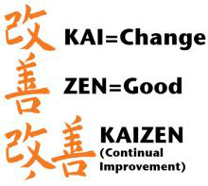
A. KAIZEN PROGRAMME
According to JICA “Kaizen” is a general term for “techniques and tools for improvement of quality and productivity”
Notes:
Japan International Cooperation Agency (JICA)

Slide 11
KAIZEN PROGRAMME: CRITERIA
The target audience are Small and Medium Enterprises
Small- minimum 11 employees and Medium- 20 or more permanent employees
The enterprises are classified as emerging or stable enterprises according to the business life cycle
The enterprises prioritised from manufacturing, agriculture and agro-processing sectors
The enterprises have physical premises and
Operational for at least two years.

Slide 12
OBJECTIVES
To introduce the key concepts and tools of Kaizen
Identify Kaizen Champions and Capacitate the Champions with tools
To create active participation
To facilitate problem solving techniques aimed at improving Key Performance Indicators such as Cost, Quality, Speed, Delivery, Morale and Safety
Define key activities to drive continuous improvement.

Slide 13
Kaizen Programme Overview
4 Month Programme
Baseline Assessment and Capacity Building
Performance Monitoring/ Impact Analysis
Process Analysis and project identification
Implementation
Kaizen Champions: Capacity building
  Waste Elimination
  Train Kaizen team on the Kaizen tools
  Map the process and Identify projects
  Create action plan and target dates
  Implementing identified improvement initiatives
  Tracking performance
  Ensuring Sustainability
Capacity Buildinga | Report | Report | Report
Register, initial baseline report | Process Analysis and Action Plan | Implementation activities - Site visit reports | Impact Analysis, Kaizen Champions certification and Close Out

Slide 14
OUTCOMES
Improve quality, productivity, delivery, eliminate waste and reduce cost
Encourage progressive mindsets amongst managers and workers
Empower team members to innovate
Builds teamwork and enhances communication
Creates an organisation that continuously improves and
Create a safe and decent work environment.

Slide 15
B. WORKPLACE CHALLENGE PROGRAMME (WPC)
It is a dtic supply-side programme managed by Productivity SA, to assist South African organisations to enhance productivity and competitiveness
Through:
Improving workplace relations,
Implementing world class practices/ Best Operating Practices (BOP)
Sharing and disseminating experiences.

Slide 16
OBJECTIVES
Improved Productivity & Competitiveness
Collaboration
Best Practices
Sharing lessons

Slide 17
PROGRAMME CRITERIA
The target audience are Small and Medium Enterprises
Ideally, more than 20 permanent employees
The enterprises are classified as stable enterprises according to the business life cycle
The enterprises prioritised from manufacturing, agriculture and agro-processing sectors
The enterprises have physical premises and
Operational for at least two years.

Slide 18
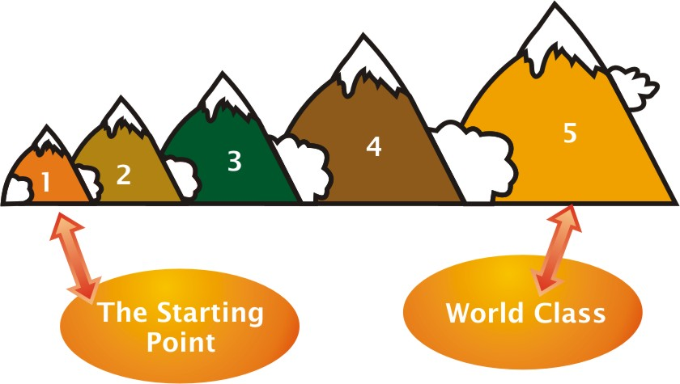
BEST OPERATING PRACTICES - WORLD CLASS

Slide 19
BEST OPERATING PRACTICES
The key strategies of best practice organisations include:
Implementing leadership practices that promote teamwork, participation, continuous learning and flexibility
Focusing on simultaneous improvement of quality, speed/delivery; cost and morale
Establishing close links with customers and suppliers
Driving both linear and non-linear improvement initiatives
Eliminating all forms of waste and making value flow.
Following Womack, James P. & Daniel T. Jones (1996) Lean Thinking: Banish Waste and Create Wealth in Your Corporation, Simon & Schuster

Slide 20
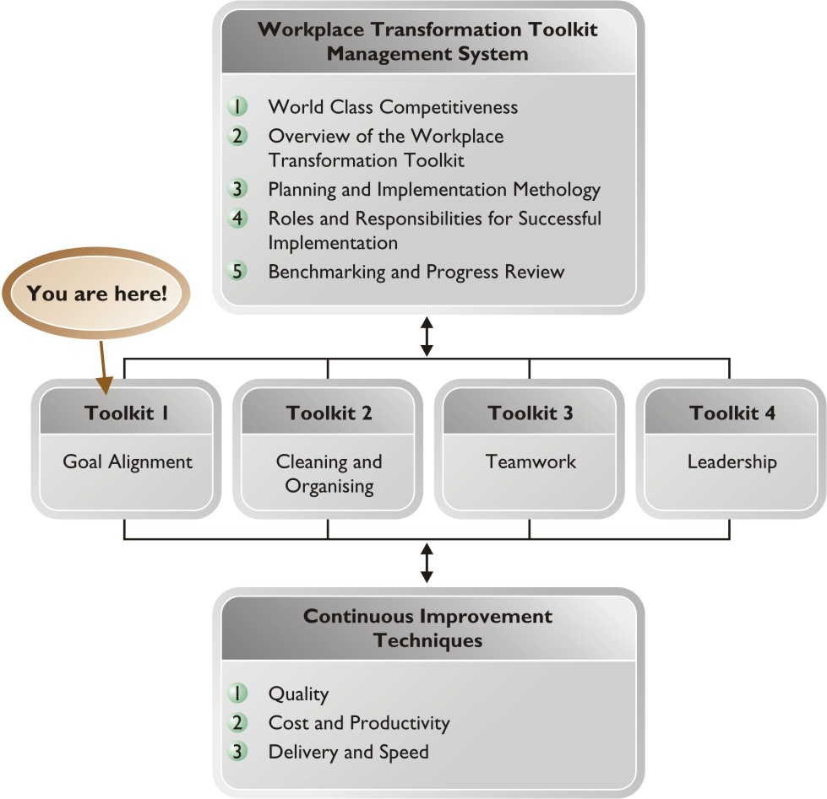
WORKPLACE TRANSFORMATION TOOLKIT MANAGEMENT SYSTEM

Slide 21
WORKPLACE TRANSFORMATION TOOLKIT: FOUNDATION TOOLKITS (6 -12MONTHS)
Toolkit 2: Cleaning and Organising
5S (sort, set in order, shine, standardise and sustain)
Makes work easier
Energises teams
Improves the physical environment
Improves productivity by reducing wasteful activities such as searching
Gets teams thinking about improving processes and efficient workplace layouts
Toolkit 1: Goal Alignment
Align goals top down and bottom up
Engage employees in the organisation through the mini-business unit concept.
Implement visual performance management of Quality, Speed, Cost Safety & Morale
Create an environment for problem solving, innovations and continuous improvement.

Slide 22
WORKPLACE TRANSFORMATION TOOLKIT: SUPPORTED TOOLKITS
Toolkit 3: Teamwork
Creating a learning environment for skills enhancement
Build a competent multi-skilled and versatile team
Integrating performance management focused on the achievement of organisational goals
Toolkit 4: Leadership
Strengthening leadership skills that go beyond management skills.
Coaching team members
Motivating the team
Empowering the team
Managing change.

Slide 23
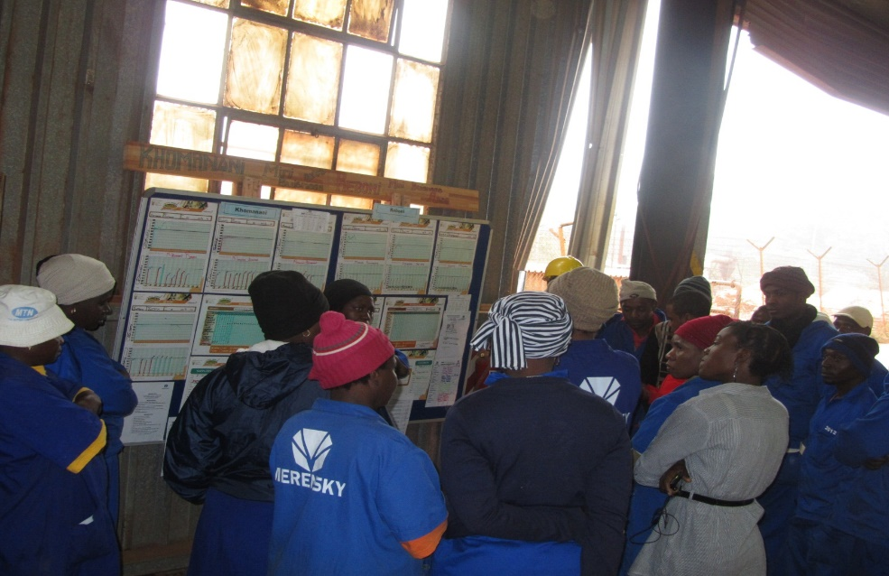
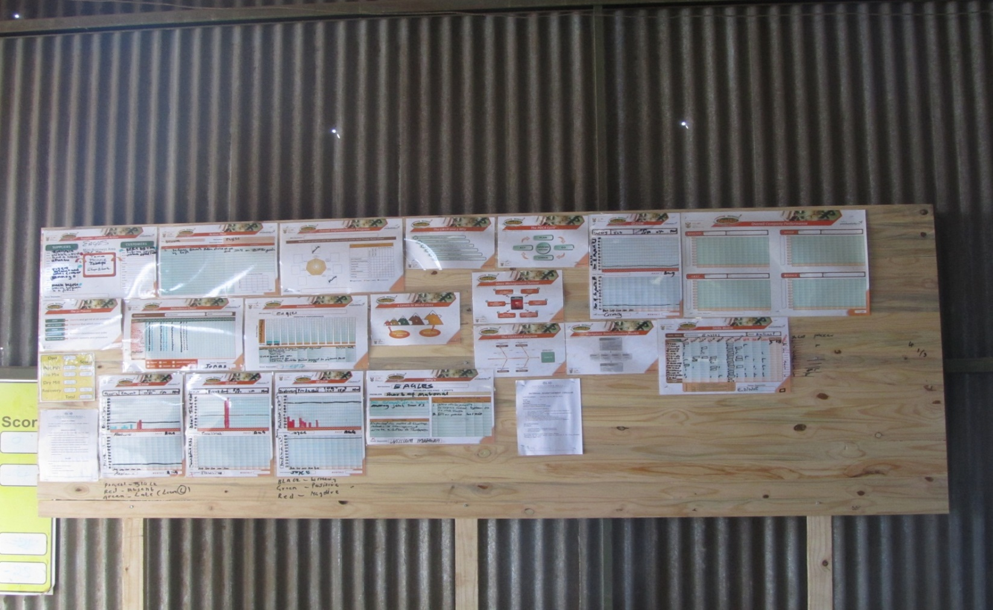
COMPANY OUTCOMES
Goals Developed and Communicated to all
Self-managed teams developed (MBUs)
People take responsibility of their own accord
Innovation part of organisations culture
Improved relationships from all stake holders
Sense of belonging to the organisation
Problem solving culture.

Slide 24

2. Business Turnaround & Recovery (BT&R) Programme
Assist
The programme seeks to assist:
BT&R Vision
To save jobs and create conditions conducive for job retention and job creation.
The potential applicant in financial and/or operational distress and/or decline.
There must be a reasonable prospect to turn the company around
The Declaration of the Presidential Jobs Summit (October 1998) outlined a Turnaround Solutions Programme (now called Business Turnaround and Recovery) that aims to prevent job losses or a decline in
Intent
To provide assistance
non-financial
different
Inspire
Seeks to inspire enterprises to be more vigilant about issues relating to job retention to mitigate on-time performance/productivity decline that increases the likelihood of job losses.
to
employment. Supported by recent 2018 Job Summit and are aligned to the economic reconstructing
organisations and companies to increase productivity, profitability, and service, as well as to save and retain existing jobs.
and
UIA s5(d) as
recovery plan and
amended
12

Slide 25

Qualifying Criteria
The company must be in operation for at least 2 years.
BT&R Application forms.
At least have 2 years of most recent financial statements.
SARS Pin to confirm compliance and validity.
UIF stamped UI19 Forms/EMP201 full report.
14

Slide 26
BT & R PROCESS FLOW
Identify the Company
Turnaround
Confirmed?
Crisis?
Nurturing Process
Financial Assessment
Yes
Yes
Crisis Management
No
No
Crisis Mitigated?
Project Closed
Project Closure
No
No
Timeframe from beginning to end is a maximum of 12 Months.
Timeframe from the workplan approval to closeout is a maximum of 9 months.
Yes
Strategy Implementation/ Interventions
&
Project Monitoring
Champions Training
In-depth
Assessment
Future Forum Establishment and Capacitation
Project Closeout
Impact Assessment
Post Implementation
Project Closed
Case Study

Slide 27
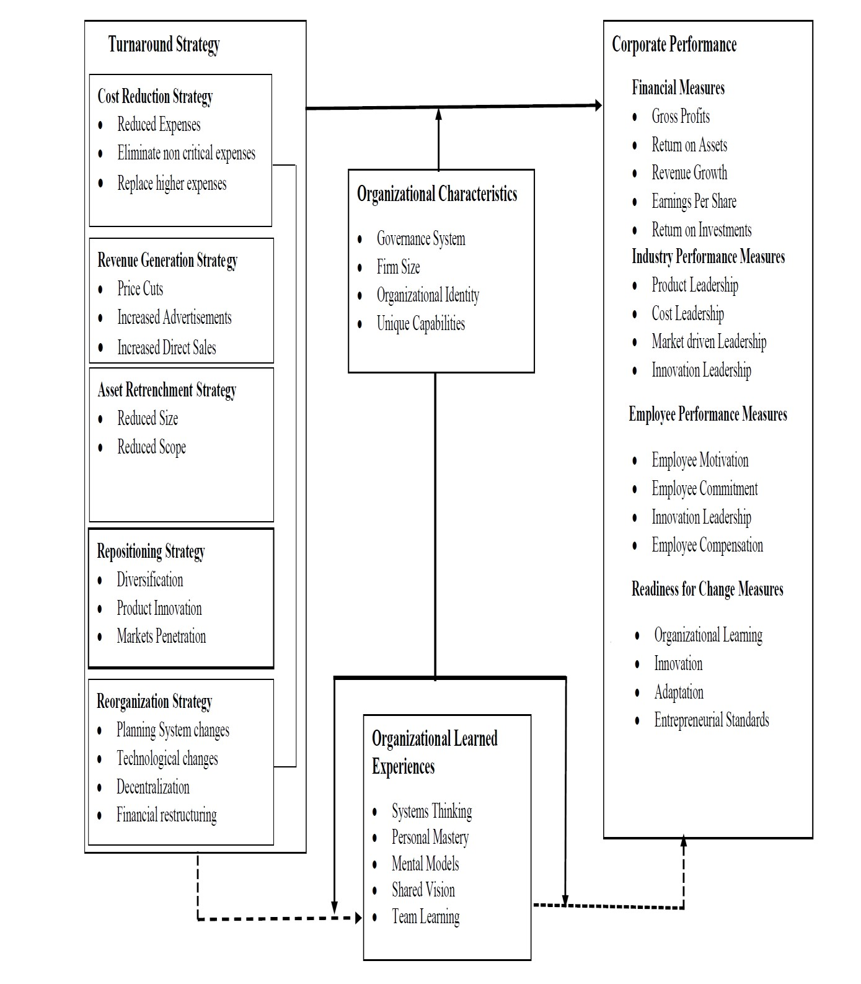













Turnaround & Recovery Strategies
Driven by Change/ Business Development Consultant
Close-out
Acquisition
Co. I.d problem
areas
Business Turnaround and Recovery
Strategy/
Plan
implementa
tion
Enterprise-Based Productivity
Forums
Establishment &
Capacitation
Co. develop turnaround strategy
In-depth Assessment/ Work Plans
Co. Implement turnaround strategy
16

Slide 28





BT&R Newsletters – Our Impact
Find more about the BT&R Programme, the impact we have made and successful stories by reading the BT&R Newsletters on: https://productivitysa.co.za/
32

Slide 29

3. RESEARCH, INNOVATION AND STATISTICS (RIS)
Aims to:
Measure and evaluate productivity and competitiveness holistically across all levels – macro, sector, and micro.
Develop and maintain databases and best practice productivity and competitiveness systems, Business Model Innovation and Products and Services Innovation to improve quality and access to services
Undertake and publicises Productivity related Research and Statistics
Statistics
Productivity Statistics
IMD Competitiveness Report
Research
Economic Research
Sector Studies

Slide 30
TARGET MARKET
Businesses, with a focus on SMMEs (both formal and informal) in the productive/Industrial sectors of the economy which are Labour Intensive.
Prioritise the participation of historically disadvantaged people and regions- supporting meaningful BBBEE
Our Customer segments are:
  businesses in economic distress
  start-ups
  Stable businesses
Programme interventions are linked to the Sector Master Plans (SMPs) and the District Development Model (DDM)
30

Slide 31
PRIORITY SECTORS
Sector 1: Industrial Sector:
Automotive
Clothing Textile Leather and Footwear
Gas Chemicals and Plastics
Renewables/Green Economy
Steel and Metal Fabrication
Sector 2: Agriculture and Agro-processing
Sector 3: Mining: Minerals and Beneficiation
Sector 4: Tourism
Sector 5: High Tech Sectors/Knowledge based:
Digital Economy, ICT and Software Production, Digital Economy, Health Economy, Defence Economy
Sector 6: Oceans Economy

Slide 32
CONTACT DETAILS
Mpho Mathelemusa
Senior Productivity Practitioners: Competitiveness Improvement Services
Region1 (Limpopo, Gauteng and Northwest)
011 848 5300
Or
Mphoma@productivitysa.co.za - 0720269918
Or
info@productivitysa.co.za
www.productivitysa co.za
Mpho Matjeke
Acting Senior Manager
Business Turnaround & Recovery
Region1 (Limpopo, Gauteng and Northwest)
011 848 5300
Mphom@productivitysa.co.za - 0716090611
Or
info@productivitysa.co.za
www.productivitysa co.za

Slide 33
THANK YOU

