Slide 1
GAUTENG GROWTH AND DEVELOPMENT AGENCY

Slide 2
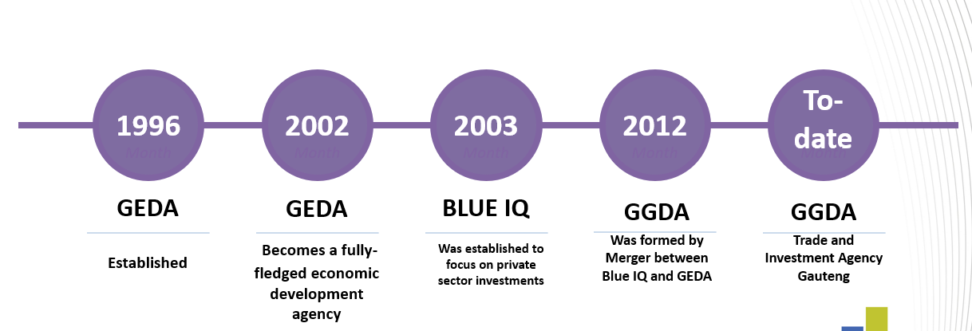
ABOUT THE GAUTENG GROWTH & DEVELOPMENT AGENCY (GGDA)
ABOUT THE GAUTENG GROWTH & DEVELOPMENT AGENCY (GGDA)
Our Mandate
Our Vision
Our Mission
The implementing arm of the Gauteng Department of Economic Development and to assist the department to lead, facilitate and manage sustainable job creation and inclusive economic growth and development in the Gauteng Cityy Region.
To create an enabling environment for ease of doing business, strategic infrastructure development and social transformation, thus positioning Gauteng as a leading Global City Region
The premier catalyst of innovative and sustainable growth and socio-economic development within the Southern African region.
Attraction of foreign direct investment (FDI) and domestic direct investment that supports the modernization and reindustrialization of Gauteng’s economy. Increase the global investment and trade footprint of Gauteng enterprises.
Increase intra-Africa trade

Slide 3
GAUTENG GROWTH & DEVELOPMENT AGENCY (GGDA)’s FUNCTIONAL AREAS
TRADE AND INVESTMENT | ECONOMIC INFRASTRUCTURE | BUSINESS INTELLIGENCE & RESEARCH
To attract foreign and domestic direct investment into Gauteng and increase the global investment and trade footprint of Gauteng enterprises. | To develop strategic economic infrastructure that supports and facilitates economic transformation and the reindustrialisation of Gauteng | To provide economic Research, Economic Information and Business Intelligence

Slide 4
GGDA SUBSIDIARIES
The purpose of the Gauteng Growth and Development Agency is to provide specialized and focused strategic capability for the Gauteng Province to implement its economic development policies and strategies.
The AIDC manages the Automotive Supplier Park (ASP) and provides services to the automotive sector and the automotive original equipment manufacturers (OEMs). AIDC helps with skills development and training, incubation programmes and supply chain development.
The Industrial Development Zone (IDZ), a special economic zone set up around the OR Tambo precinct, established to support industrial development with a specific focus on mineral beneficiation and value-added industry programmes that will increase Industrialisation and manufacturing capability. Agro-processing, aerospace/aviation, electronics, jewellery and pharmaceuticals manufacturing
AIDC
GIDZ
TIRE
Innovation Hub is the Science and Technology Park (STP) established with a view to spurring the development of smart industries (high- technology sectors) in Gauteng, TIH’s role is to be a catalyst for innovation and a key knowledge economy driver, in line with the Gauteng Growth and Development Strategy.
ConHill is to add to the rejuvenation of the Johannesburg Inner City through the development and promotion of the ConHill Heritage Project.
TIH
CONHILL

Slide 5
TRADE, INVESTMENT AND REGULATORY ENABLEMENT

Slide 6
WHAT WE DO
01
02
03
04
Investment Promotion and Development
Investment Facilitation
Business Retention and Aftercare
Trade Promotion
Identify and promote investment opportunities in GCR and subsidiaries
Engage foreign ministries, the international business community and chambers of commerce to promote Gauteng as the key destination for investments
Offer value-added facilitation services to investors looking to invest in Gauteng:
Guidance regarding governmental incentives and grants
Immigration facilitation services
Advocate for an investor-friendly regulatory environment.
Retention of companies invested in Gauteng and support expansion efforts
Provide aftercare services to local investors
Facilitate and promote ease of doing business in Gauteng.
Advocate for an investor-friendly regulatory environment.
Provide and support Gauteng enterprises with market access and expansion opportunities.
Increase intra-Africa trade

Slide 7
How do we do it
Proposition | How do we do it
Identify, and promote investment opportunities in GCR and subsidiaries | Develop Investment Promotion strategy to attract investment into key strategic investment areas in the GCR. This function includes Investor research, Investor Targeting, Hosting inward business delegations, and Outward investment promotion missions. Participate in industry events and collaborate with the private sector to achieve investment and trade goals.
Provide an efficient and effective investment facilitation service for domestic and foreign investors | Improve intergovernmental coordination to reduce the cost of doing business from a regulatory leveraging the support of the Invest SA One Stop Shop Gauteng. Coordination with Municipalities through the Municipal Blueprint and private sector partnerships. Participate in Sub National Committees for Ease of Doing Business to influence policy. This is also done through Conducting Aftercare Forums Industry Feedback sessions Ease of Doing Business Index review Manage expectations of investors and intervene timeously to resolve challenges experienced by local investors
Advocate for changes in the regulatory environment to enhance the ease of doing business | Participate in Sub National Committees for Ease of Doing Business to influence policy and regulatory environment to reduce the cost of investing and doing business from a regulatory perspective.
Provide and support Gauteng enterprises with expansion opportunities and market access services | Facilitate access to export markets for Gauteng enterprises through the implementation of export readiness programmes. Train Gauteng enterprises to improve their export capacity. Promote export opportunities for Gauteng products and services

Slide 8
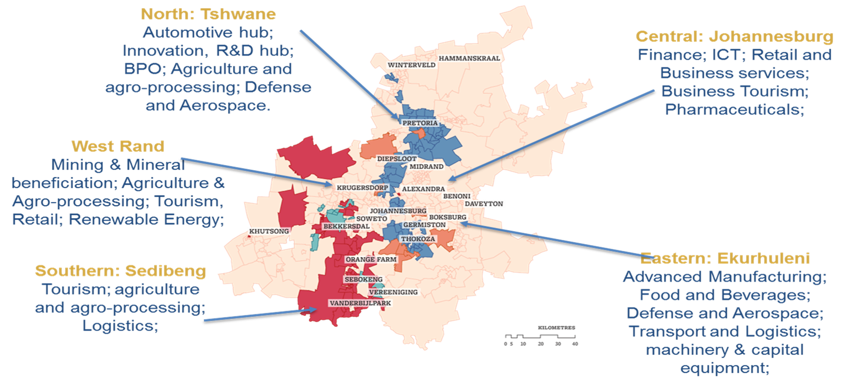
FIVE DEVELOPMENT CORRIDORS OF GAUTENG: SECTORS

Slide 9
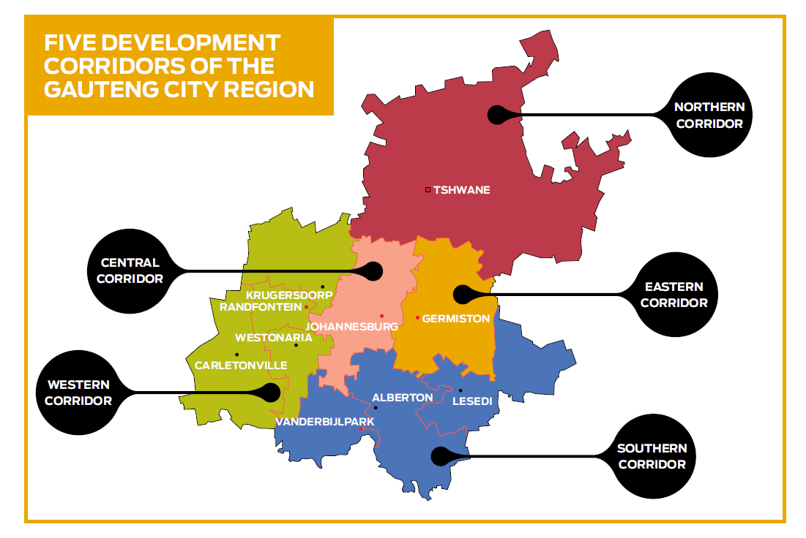
FIVE DEVELOPMENT CORRIDORS OF GAUTENG & SEZ’s
Northern SEZ (TASEZ) – Targeting Automotive Sector . Anchor Tenant – Ford
ORT SEZ – Targeting Logistics and high value low mass manufacturing. Attracting medical devices companies into precinct 2
West Rand SEZ –
SEZ designation in progress. Agro-processing and Green Energy
Vaal SEZ - Targeting green energy, Agro processing, logistics and cannabis

Slide 10
























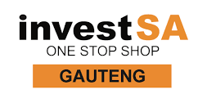












OUR KEY PARTNERS
Private sector and multi-lateral Institutions
National Government/Agencies
1
4
2
5
Local Government
Provincial Government/Agencies
3
6

Slide 11

































NOTABLE PLAYERS

Slide 12
THANK YOU!!!
Asisipho Mandaza BUSINESS RETENTION, EXPANSION & AFTERCARE asisiphom@GGDA.CO.ZA

